Slide 1


UNIVERSITY INSTITUTE OF ENGINEERING
COMPUTER SCIENCE & ENGINEERING
Introduction to Information Security
(Subject Code:20CST-354/ITT-354)
Prepared By : Er. Puneet kaur(E6913)
INTRODUCTION
DISCOVER . LEARN . EMPOWER

Slide 2
(RSA Algorithm & Diffie Hellman Algorithm)

Slide 3
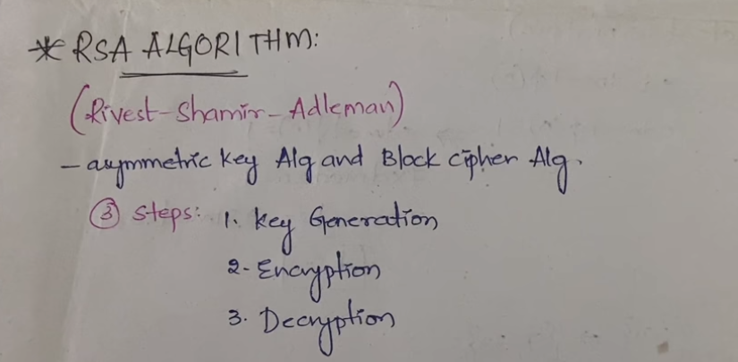

Slide 4
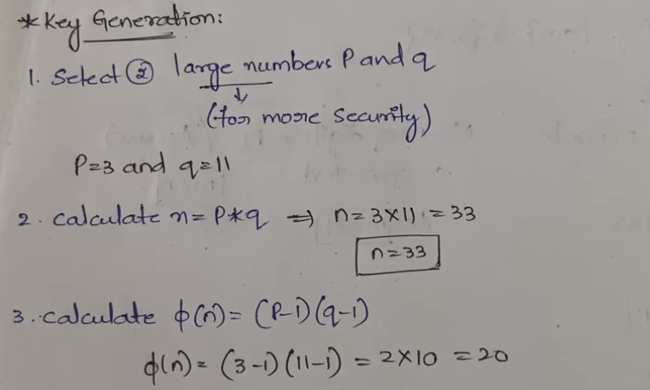

Slide 5
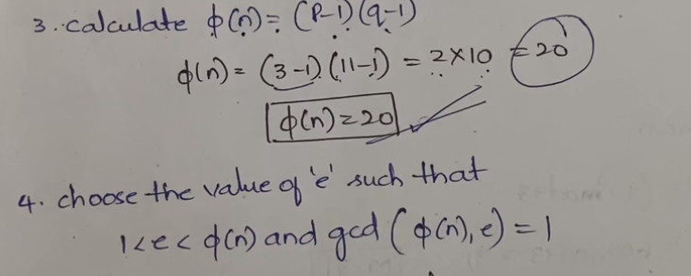

Slide 6
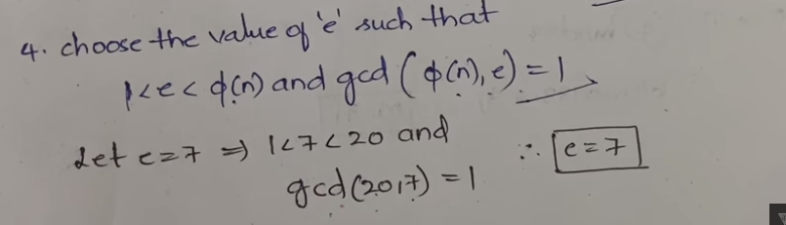

Slide 7
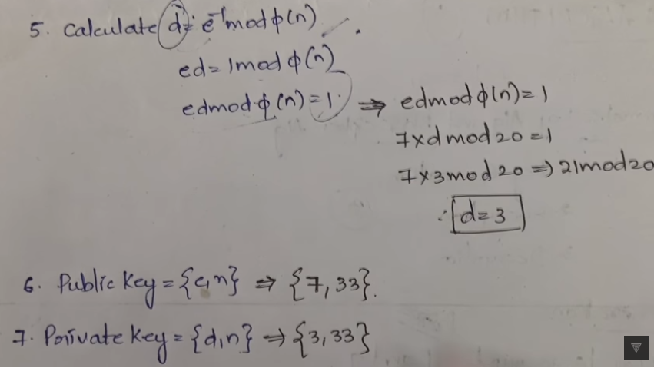

Slide 8
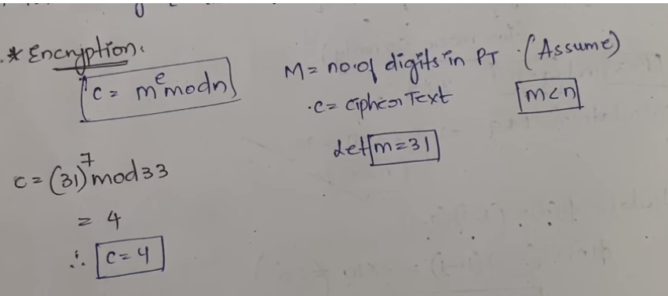

Slide 9
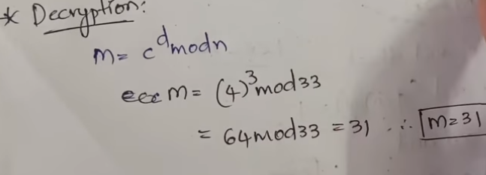

Slide 10
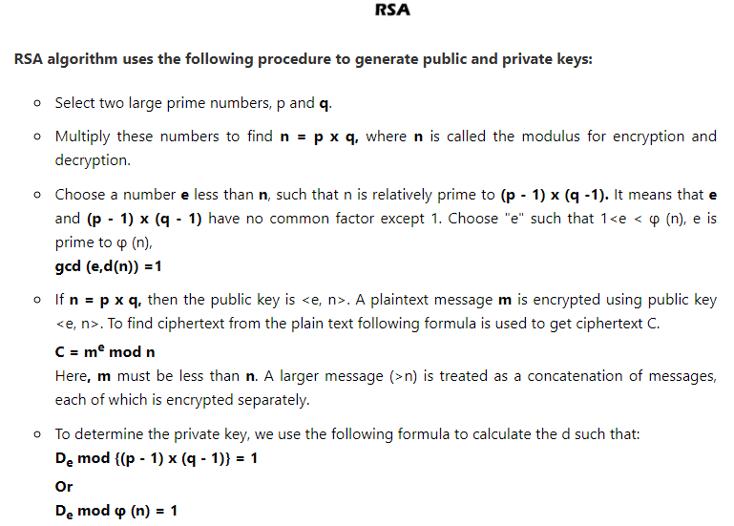

Slide 11
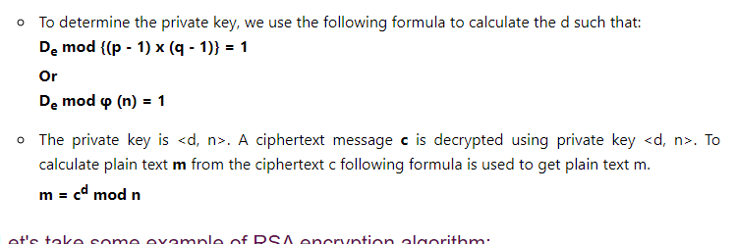

Slide 12
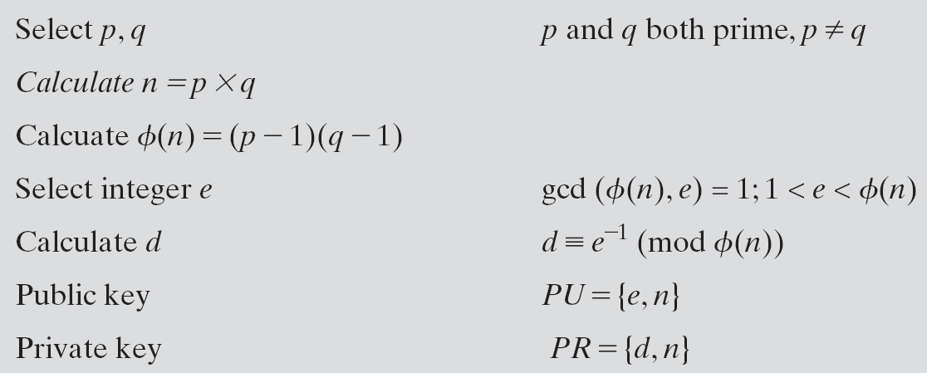
RSA Algorithm

Slide 13
RSA Algorithm
Example
Select two prime numbers p = 17 and q = 11
Calculate n = p x q = 17 × 11 = 187
Calculate Φ(n) = (p - 1) (q - 1) = 16 × 10 = 160
Select e such that e is relatively prime to Φ(n) = 160 and less than Φ(n); we choose e = 7

Slide 14
RSA Algorithm
Determine d such that de ≡ 1 (mod 160) and d < 160.
The correct value is d = 23
because 23 × 7 = 161 = (1 × 160) + 1;
d can be calculated using the extended Euclid’s algorithm.
The resulting keys are:
Public key PU = {7, 187}
Private key PR = {23, 187}.

Slide 15
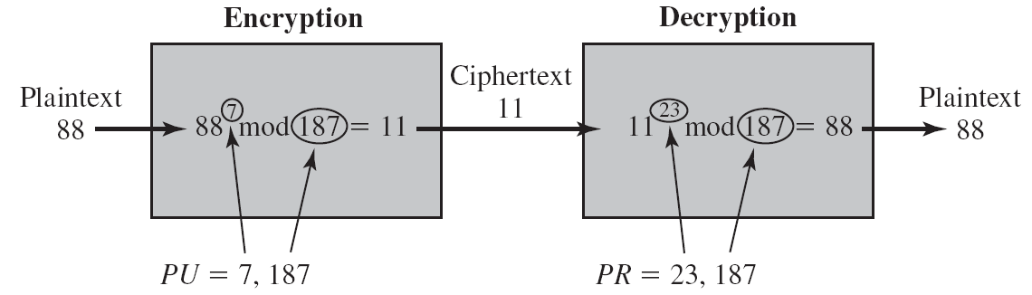
RSA Algorithm
M = 88
C = 88⁷ mod 187
= (88⁴ mod 187) x (88² mod 187) x (88¹ mod 187)
= 11

Slide 16
Requirements of RSA Algorithm
It is possible to find values of e, d, n such that
M^{ed} mod n = M for all M < n.
It is relatively easy to calculate Me mod n and C^{d} mod n for all values of M < n.
It is infeasible to determine d given e and n.

Slide 17
Security of RSA Algorithm
Four possible approaches to attacking the RSA algorithm are
Brute force attack
Involves trying all possible private keys.
Defense against the brute-force approach is to use a large key space. Thus, the larger the number of bits in d.
key generation and encryption/decryption, are complex.
The larger the size of the key, the slower the system will run.

Slide 18
Security of RSA Algorithm
Mathematical attacks
Effort to factoring the product of two primes.
Timing attacks
These depend on the running time of the decryption algorithm.
Chosen ciphertext attacks
This type of attack exploits properties of the RSA algorithm.

Slide 19
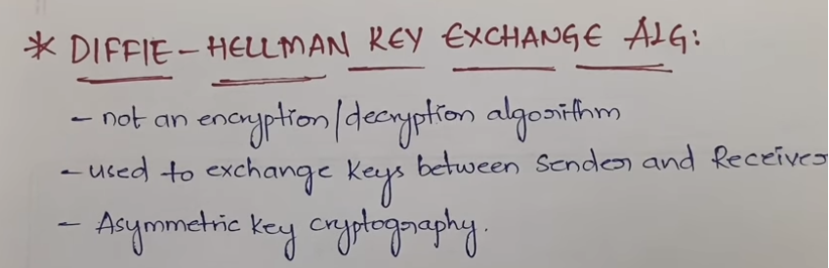

Slide 20
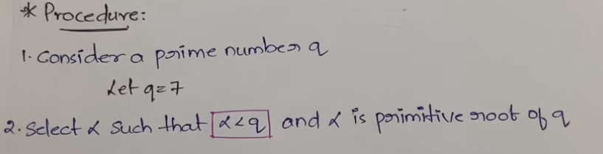

Slide 21
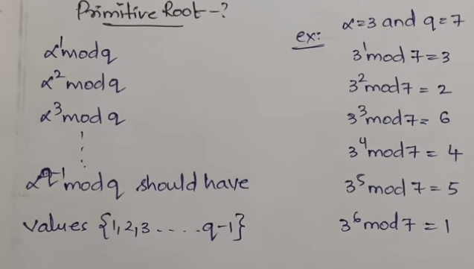

Slide 22
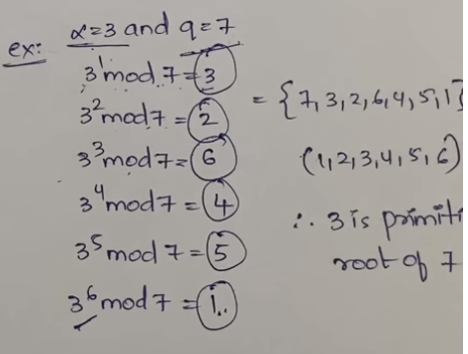

Slide 23
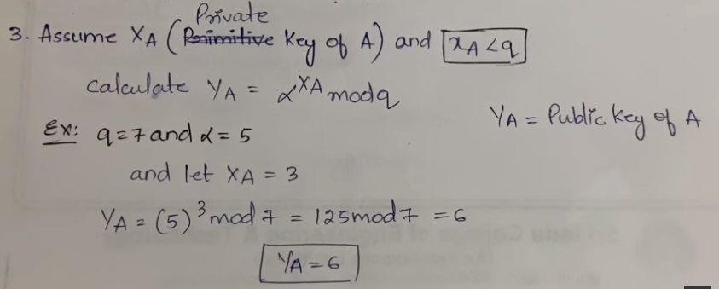

Slide 24
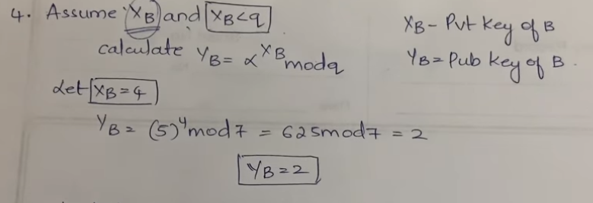

Slide 25
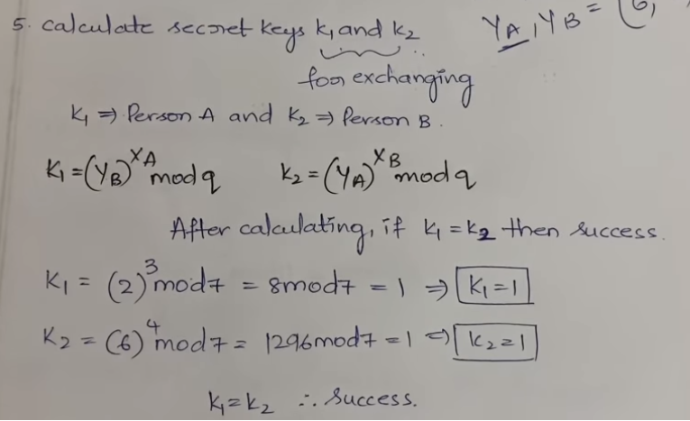

Slide 26
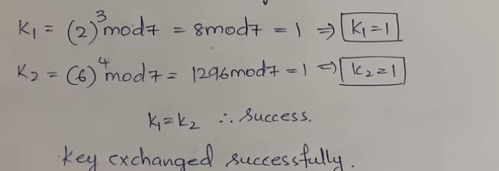

Slide 27
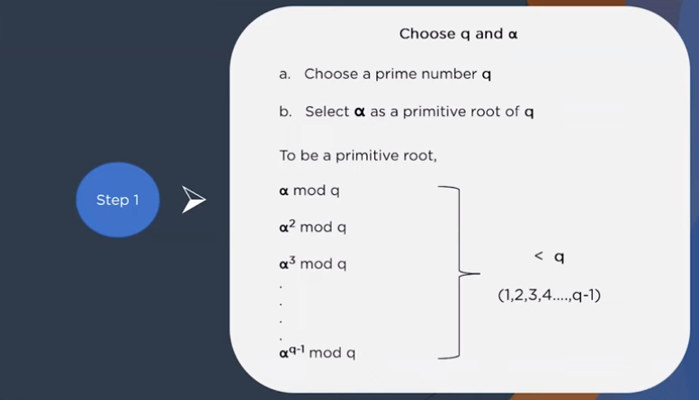

Slide 28
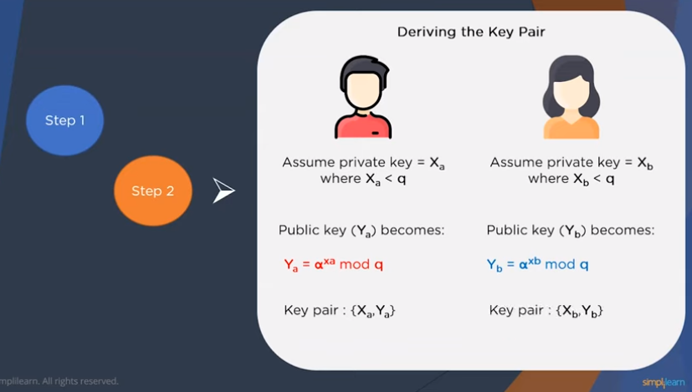

Slide 29
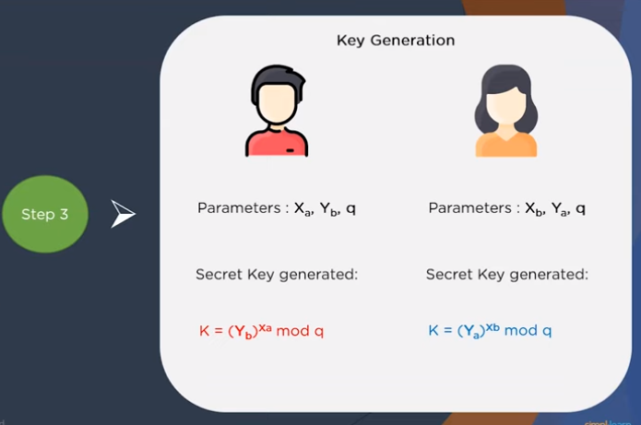

Slide 30
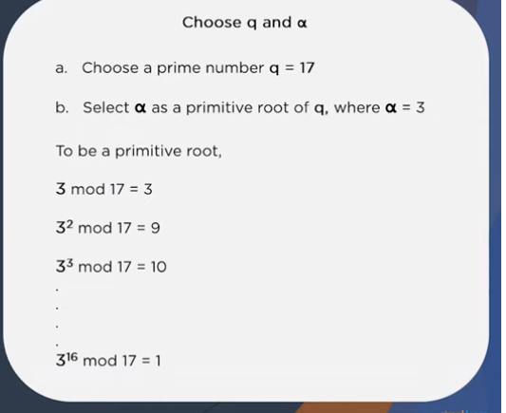

Slide 31
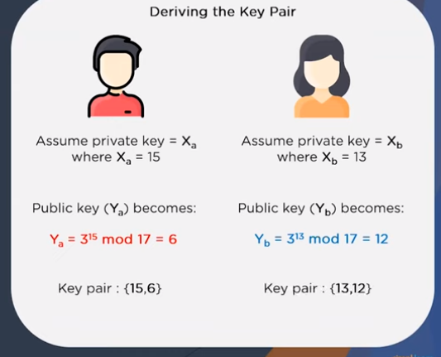

Slide 32
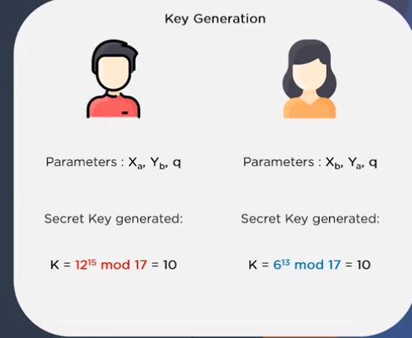

Slide 33
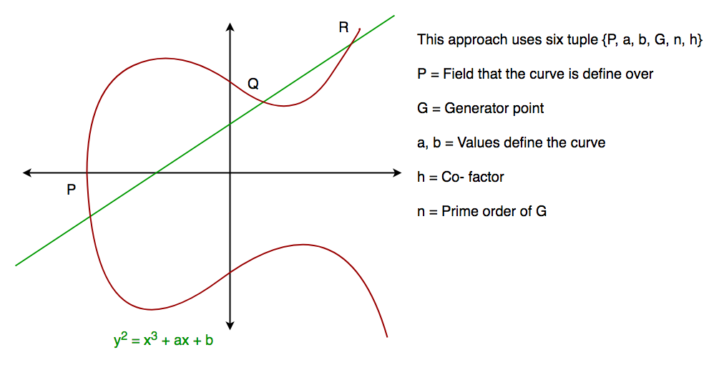
Elliptic Curve Cryptography (ECC)

Slide 34
Diffie-Hellman Algorithm
The Diffie-Hellman algorithm is being used to establish a shared secret communications while exchanging data over a public network.
the elliptic curve is used to generate points and get the secret key using the parameters.
For practical implementation of the algorithm, we will consider only 4 variables one prime P and G (a primitive root of P) and two private values a and b.

Slide 35
References
http://www.brainkart.com/article/Classical-Encryption-Techniques_8339/
https://www.tutorialspoint.com/cryptography/index.htm
https://www.geeksforgeeks.org/cryptography-introduction/
https://www.techopedia.com/definition/1770/cryptography#:~:text=Cryptography%20involves%20creating%20written%20or,information%20to%20be%20kept%20secret.&text=Information%20security%20uses%20cryptography%20on,transit%20and%20while%20being%20stored.

Slide 36
References
https://www2.slideshare.net/lineking/classical-encryption-techniques-in-network-security?qid=e388c29f-793d-4f2b-bcaf-9d22e9ca07b5&v=&b=&from_search=1

Slide 37
E- Books Recommended
https://www.pdfdrive.com/cyber-security-books.html
https://bookauthority.org/books/new-cyber-security-ebooks
https://bookauthority.org/books/best-cyber-security-ebooks
https://www.freetechbooks.com/information-security-f52.html

